Slide 1
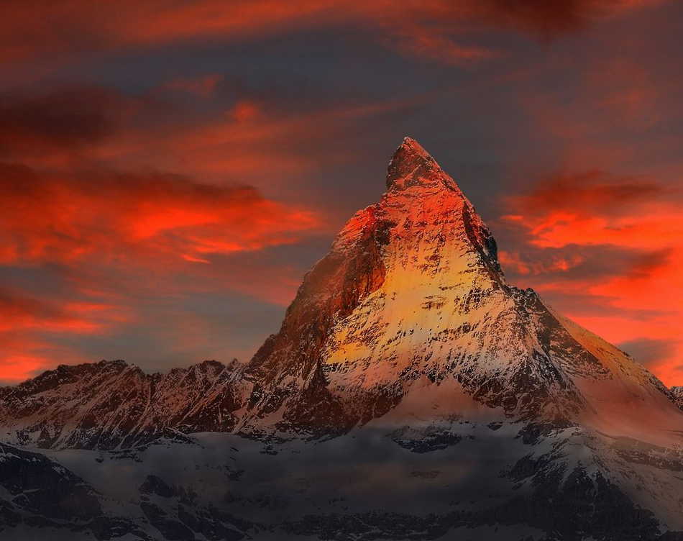
Hymn of Heaven

Slide 2
G Gsus G
How I long to breathe the air of Heaven
Em C D
Where pain is gone and mercy fills the streets
G C G D Em
To look upon the one who bled to save me
C D G Gsus G
And walk with Him for all eternity
To CHORUS

Slide 3
C D G
Oh, There will be a day When all will bow before Him
G C Em D
There will be a day When death will be no more
G C D G Em
Standing face to face With He who died and rose again
D G G
Holy holy is the Lord
TO VERSE

Slide 4
G G G
Every prayer we prayed in desperation
D Em C D
The songs of faith we sang through doubt and fear
G C G D Em
In the end we’ll see that it was worth it
C D G C
When He returns to wipe away our tears
TO CHORUS

Slide 5
C F G C
Oh, There will be a day When all will bow before Him
C F Am G
There will be a day When death will be no more
C F G C G Am
Standing face to face With He who died and rose again
F G C
Holy holy is the Lord
TO VERSE

Slide 6
C F C
On that day we join the resurrection
Am F G
And stand beside the heroes of the faith
C F C G Am
With one voice a thousand generations
F G C
Sing “worthy is the Lamb who was slain”
TO VERSE

Slide 7
C F C
On that day we join the resurrection
Am F G
And stand beside the heroes of the faith
C F C G Am
With one voice a thousand generations
F G C
Sing “worthy is the Lamb who was slain”
F G C Csus C
“Forever He shall reign”
TO CHORUS

Slide 8
C F G C
So let it be today we shout the hymn of Heaven
C F Am G
With angels and the Saints we raise a mighty roar
C F G C G Am
“Glory to our God” who gave us life beyond the grave
F G C
Holy holy is the Lord
TO CHORUS

Slide 9
C F G C
So let it be today we shout the hymn of Heaven
C F Am G
With angels and the Saints we raise a mighty roar
C F G C G Am
“Glory to our God” who gave us life beyond the grave
F G Am
Holy holy is the Lord
F G Am
Holy holy is the Lord
F G C Csus C
Holy holy is the Lord
END

